Slide 1

HOW DO THEORETICAL TOOLS OF PUBLIC FINANCE WORK?
Group 3

Slide 2

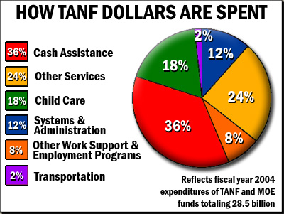
The TANF program was created in 1996 by a major overhaul of the cash welfare system in the United States.The cash welfare system distributes money from taxpayers to low-income families.

Slide 3
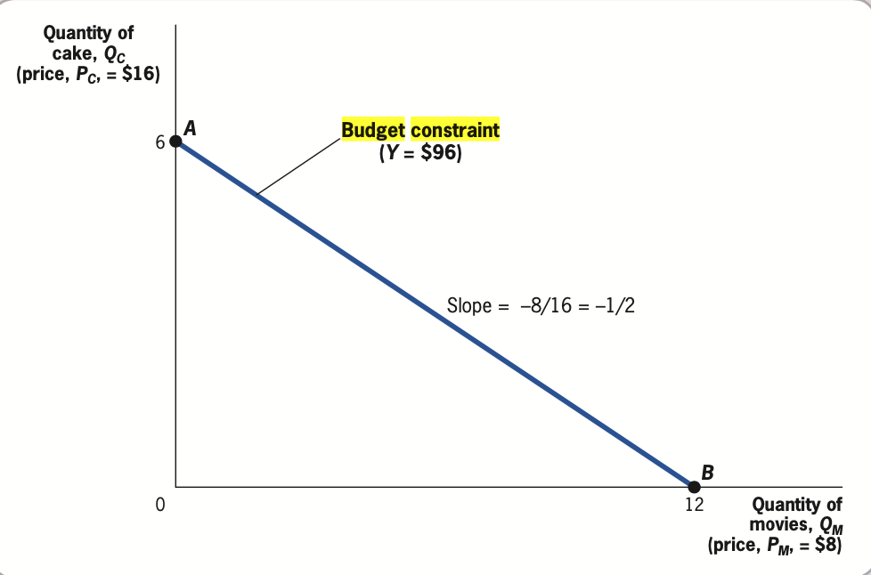
Budget Constraints
Andrea’s budget constraint is represented math- ematically by Y 5 PCQC 1 PMQM, where Y is her income, PC and PM are the prices of cakes and movies, and QC and QM are the quantities of cakes and movies she buys. That is, this expression says that her expenditures on cakes and on movies add up to be her total income.

Slide 4
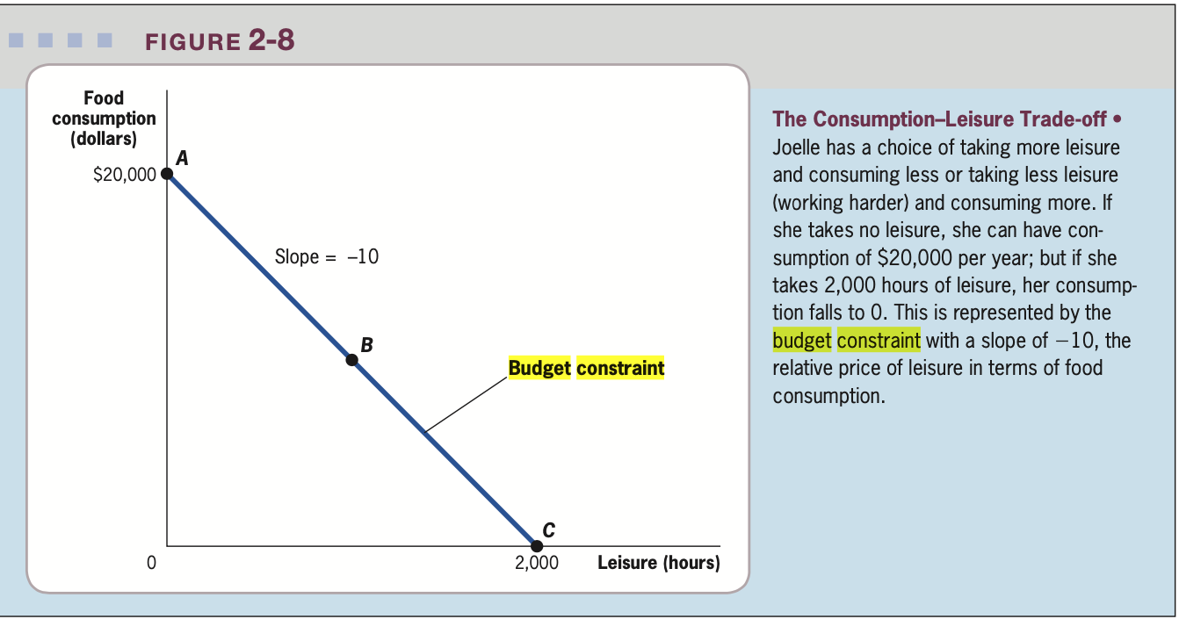
Identifying the Budget Constraint
Suppose that Joelle can work up to 2,000 hours per year at a wage of $10 per hour, that she has no other source of income, and that there is not yet a TANF program in place.
Notes:
https://www.consumer.ftc.gov/articles/what-know-about-cryptocurrency-and-scams

Slide 5

2. The effect of TANF on the budget constraint.
The TANF program, which is time limited, assists families with children when the parents or other responsible relatives cannot provide for the family's basic needs.

Slide 6
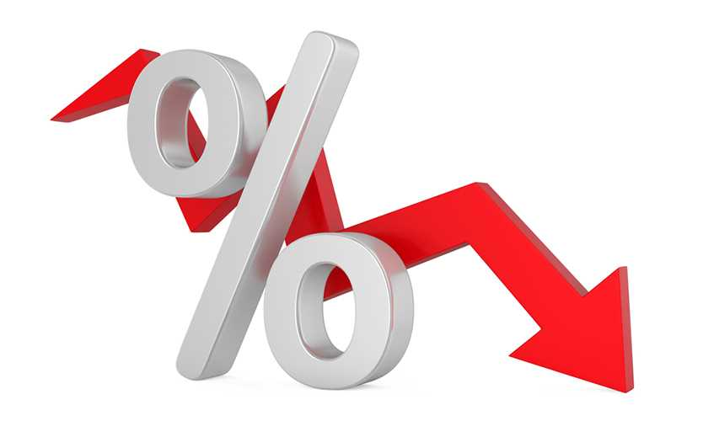

2. The effect of TANF on the budget constraint.
Benefit guarantee, or the baseline amount of money to which recipients are entitled when they enroll in the program.
Benefit reduction rate, the rate at which the baseline amount is reduced if recipients have other income.

Slide 7
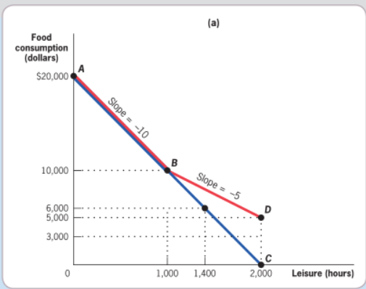
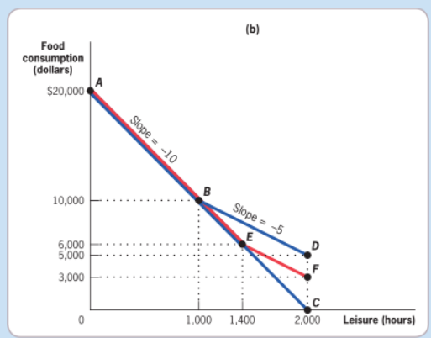
The Budget Constraint with TANF

Slide 8
2.4 Welfare Implications of Benefit Reduction:
The TANF Example Continued
The equilibrium and social welfare tools developed in Section 2.3 can be applied to evaluate the benefits and costs to society of reducing TANF benefits. The benefits are the improvement in efficiency from removing a barrier to labor supply by single mothers, raising single mothers’ labor supply and raising the size of the social surplus.

Slide 9
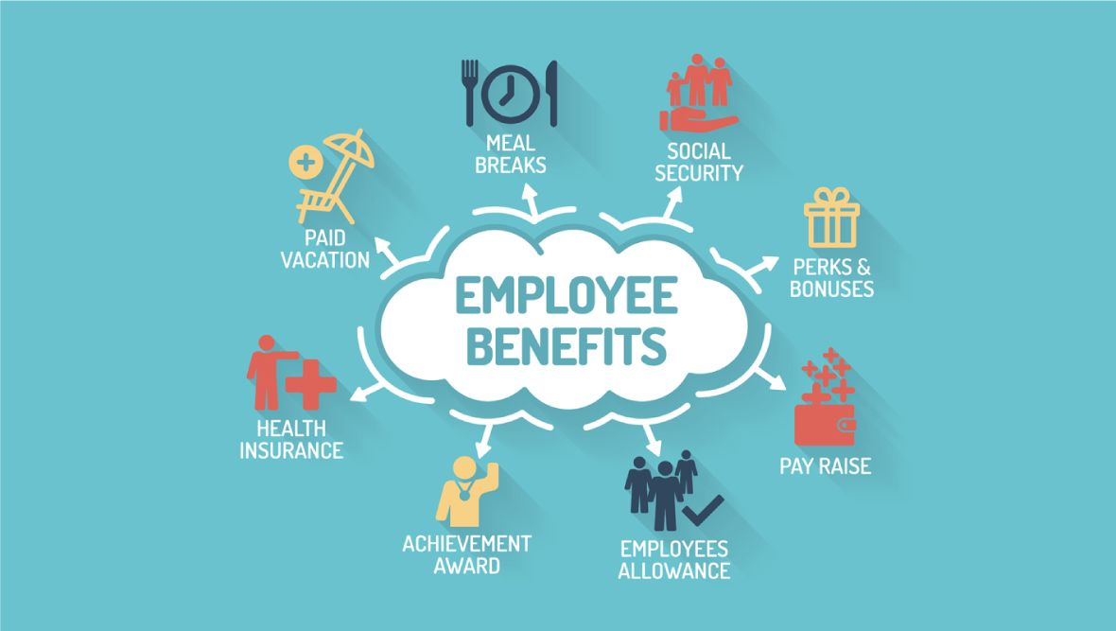
3. Efficiency
We can apply the tools of welfare analysis to model the welfare impli cations of cutting TANF benefits. Figure 2-17 shows the market for labor services by single mothers. The price of labor, the wage (W ), is on the vertical axis; the amount of hours worked in aggregate in the market (H) is on the horizontal axis
Notes:
https://www.consumer.ftc.gov/articles/what-know-about-cryptocurrency-and-scams

Slide 10
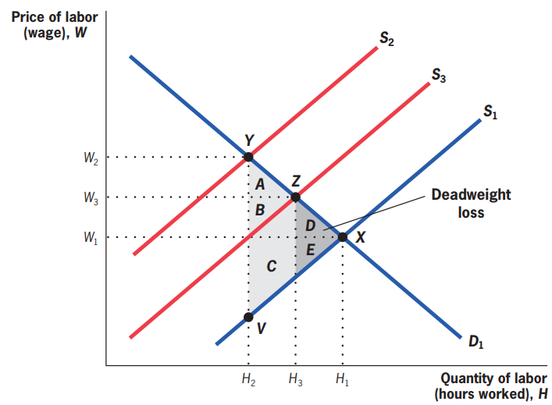
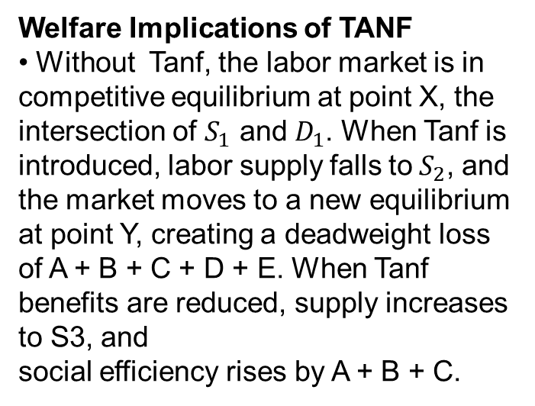
Welfare Implications of TANF
• Without Tanf, the labor market is in competitive equilibrium at point X, the intersection of $S_{1}$ and $D_{1}$. When Tanf is introduced, labor supply falls to${ S}_{2}$, and the market moves to a new equilibrium at point Y, creating a deadweight loss of A + B + C + D + E. When Tanf benefits are reduced, supply increases to S3, and
social efficiency rises by A + B + C.

Slide 11

Equity:
Given this large efficiency gain, why not cut TANF benefits? Indeed, why have the TANF program at all? As just noted, governments have programs such as TANF because their citizens care not only about efficiency but also about equity, the fair distribution of resources in society. For many specifications of social welfare, the competitive equilibrium, while being the social efficiency-maximizing point, may not be the social welfare-maximizing point.

Slide 12
4. Size-Maximizing Bureaucracy

Slide 13
Most of the lesson, we assume that Government operates in a way that MAXIMIZE SOCIAL WELFARES.
Realistically speaking, that is not the case.
➔ Government failure

Slide 14
Government failures:
The inability or unwillingness of the government to act primarily in the interest of its citizens.
Sources of government failure that we will discuss today:
Size-Maximizing Bureaucracy
Leviathan Theory
Corruption

Slide 15
Larger Government
Decide the funding of the Bureaucracy
Bureaucracy
organizations of civil servants. Has monopoly on a service
Notes:
https://www.consumer.ftc.gov/articles/what-know-about-cryptocurrency-and-scams

Slide 16
Size-Maximizing Bureaucracy (William Niskanen)
Bureaucracy prioritize maximizing its own budget, over social efficiency
The more services the department supplies, the higher will its budget be
Takes on inefficient project, where the marginal benefit is lower than marginal cost (project with huge budget but only a tiny amount of benefit)

Slide 17
Size-Maximizing Bureaucracy:
In other words:
Normal firms expand until marginal revenue = marginal cost
While for Bureaucracies, Total cost = Total benefit instead
(Sources: Wikipedia)
Some examples of Size-Maximizing Bureaucracy

Slide 18

5. Leviathan theory
Niskanen’s theory assumes that individual bureaucrats try to maximize the size of their own agencies and that a larger government tries to rein them in.
In contrast, Brennan and Buchanan (1980) see these two entities (bureaucrats and large government) as one monopolist (which they call “Leviathan”) that simply tries to maximize the size of the public sector by taking advantage of the electorate’s ignorance.

Slide 19

This view of government can explain the many rules in place in the United States and elsewhere that explicitly tie the government’s hands in terms of taxes and spending.
Likewise, a number of U.S. states have passed laws limiting the ability of local communities to raise property taxes (taxes imposed on the value of homes and businesses and the land they are built on)

Slide 20

There is no reason to have these types of “roadblocks” if a benevolent government is maximizing social welfare, but with a Leviathan government, they may be a means of putting a brake on inefficient government growth

Slide 21

Another way to combat the Leviathan tendencies of government is to ensure that politicians face electoral pressure to deliver public services efficiently, as suggested by a study by Besley et al. (2005). These authors studied the impact of the increased “political competition” in the southern United States during the twentieth century due to the enfranchisement of blacks and other groups.

Slide 22
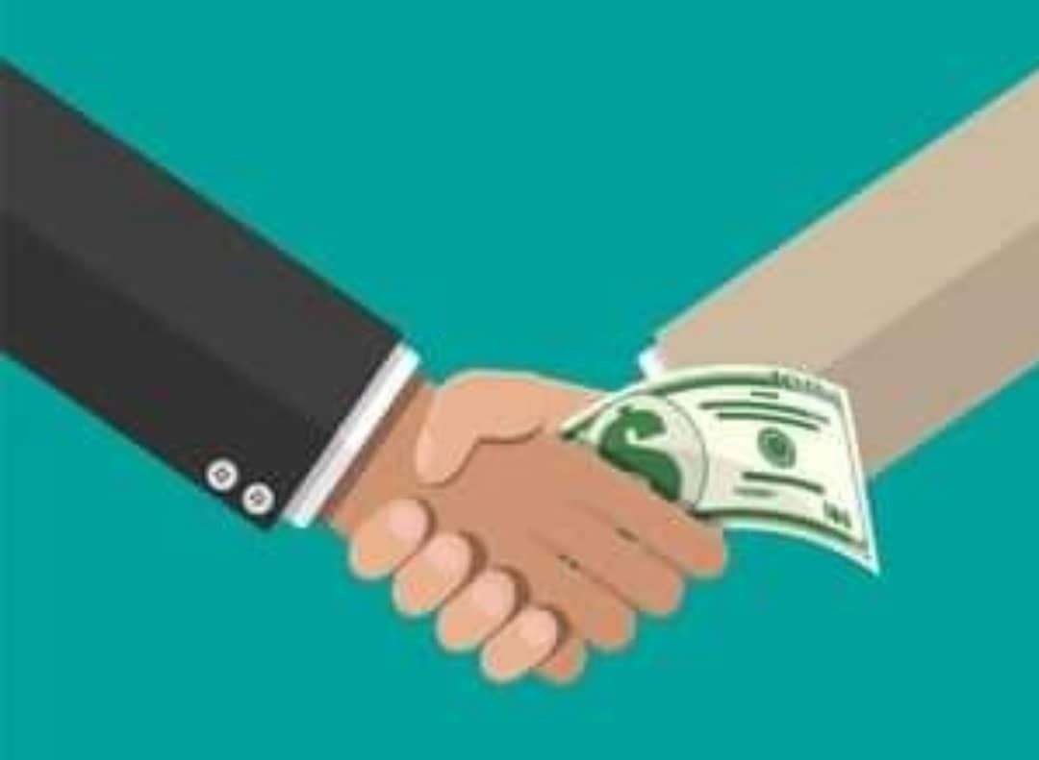
6. Corruption
The abuse of power by government officials in order to maximize their own personal wealth or that of their associates

Slide 23
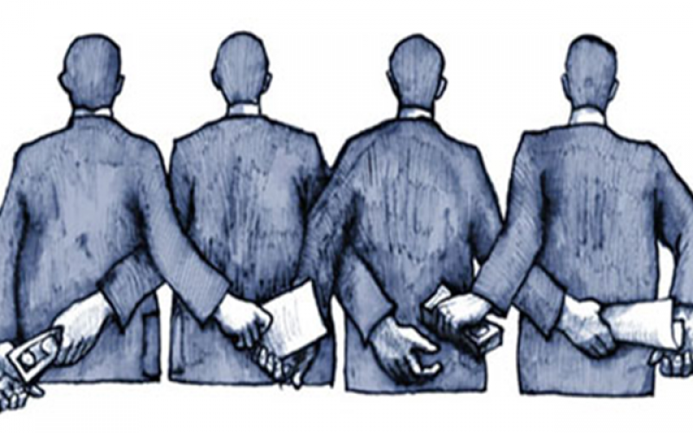
Corruption can take many forms, but the common theme is that government officials accept bribes or profit from public funds.
Corruption is an international phenomenon

Slide 24
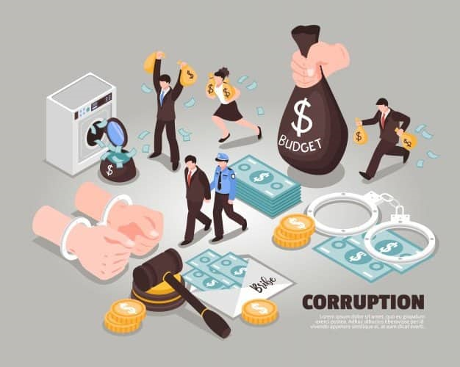
Corruption is more common in countries with less developed economies. In these countries, people often intend to hold high positions in the leadership to corrupt. For some economically developed countries with high per capita income, individuals with large assets have just started participating in politics to become leaders..

Slide 25
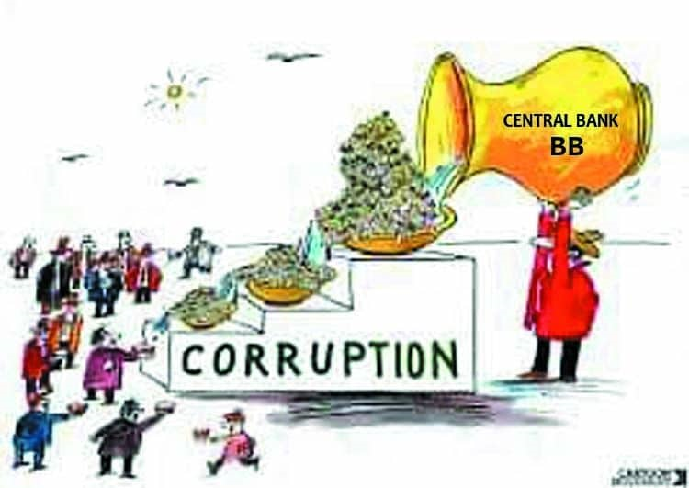
Corruption also appears more rampant in political systems that feature more red tape, bureaucratic barriers that make it costly to do business in a country..

